Slide 1
Laravel JWT authentication

Slide 2
Laravel JWT authentication
Install Laravel 9
Create a database
Connect to the database
Make the migrations
Install and set up JWT
Configure AuthGuard
Modify the User model
Create the AuthController
Create the Book model, controller, and migration
Modify the Book migration
Modify the Book model
Modify the Book controller
Add the API routes
Test the application
Register the API
Log in to the API
Test the endpoints

Slide 3
Laravel JWT authentication vs. Sanctum or Passport
Choosing the type of authentication to use in your Laravel application is based on the type of application you’re building.
Sanctum offers both session-based and token-based authentication and is good for single-page application (SPA) authentications.
Passport uses JWT authentication as standard but also implements full OAuth 2.0 authorization.

Slide 4
JWT authentication demo
Install Laravel 9
composer create-project laravel/laravel DumApp-jwt
cd DumApp-jwt
Create a database
Install and set up JWT
Install the newest version of the package using this command:
composer require php-open-source-saver/jwt-auth
Next, we need to make the package configurations public. Copy the JWT configuration file from the vendor to confi/jwt.php with this command:
php artisan vendor:publish --provider="PHPOpenSourceSaver\JWTAuth\Providers\LaravelServiceProvider“
Now, we need to generate a secret key to handle the token encryption. To do so, run this command:
php artisan jwt:secret
This will update our .env file

Slide 5
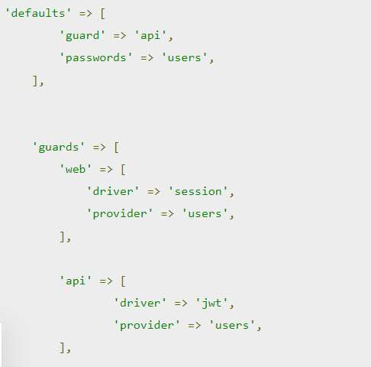
Configure AuthGuard
Inside the config/auth.php file, we’ll need to make a few changes to configure Laravel to use the JWT AuthGuard to power the application authentication.
In this code, we’re telling the API guard to use the
JWT driver and to make the API guard the default.

Slide 6
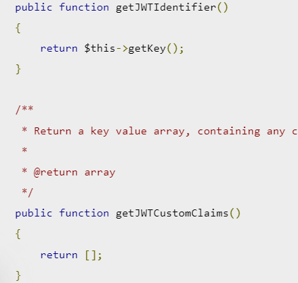
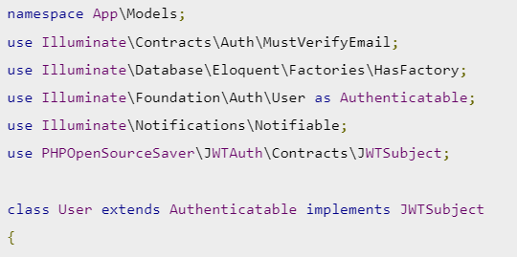
Modify the User model
In order to implement the PHPOpenSourceSaverJWTAuthContractsJWTSubject contract on our User model, we’ll use two methods:
getJWTCustomClaims() and getJWTIdentifier().

Slide 7
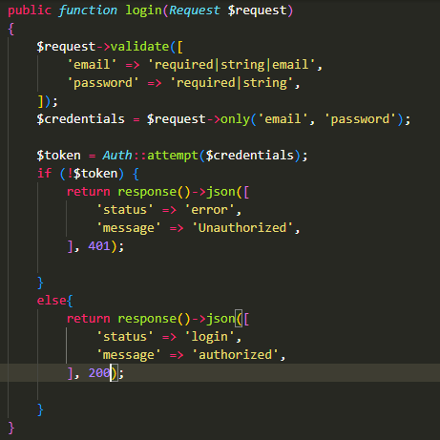
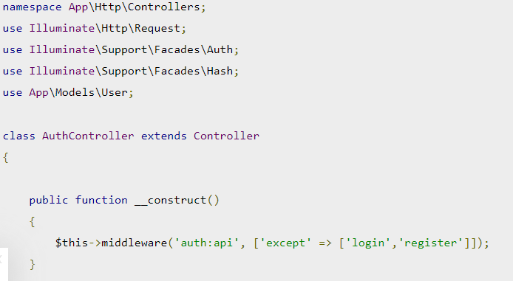
Create the AuthController
php artisan make:controller AuthController

Slide 8
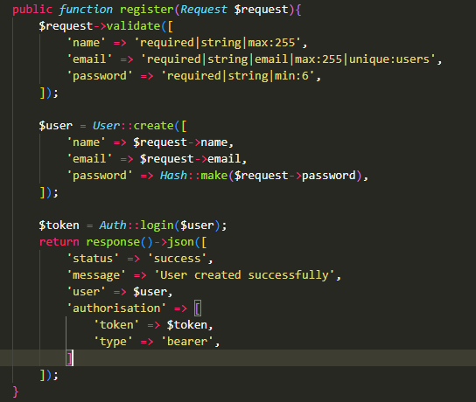
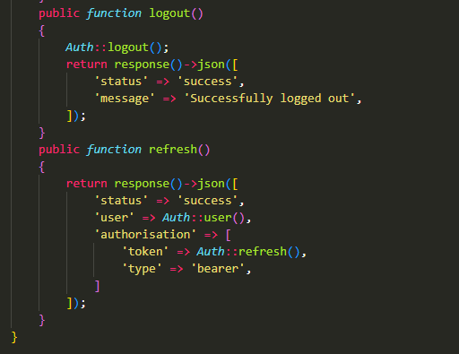

Slide 9
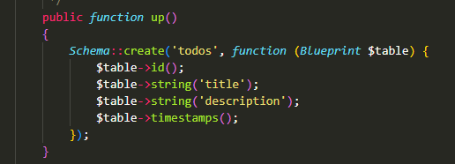
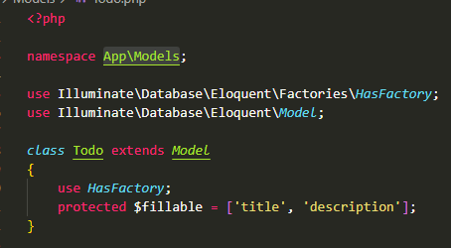
Create the todo model, controller, and migration
We’ll create the Todo model, controller, and migration all at once with the following command:
php artisan make:model Todo –mc

Slide 10
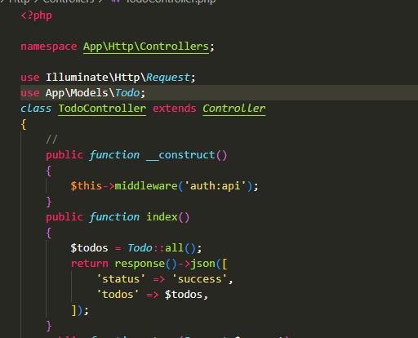
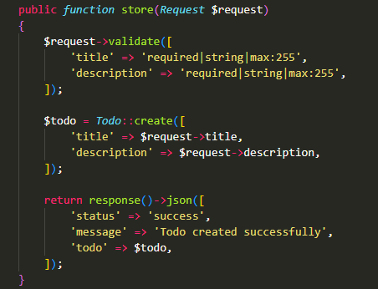
Modify the todo controller
Next, go to the app/Http/Controllers/TodoController.php file, and replace the content with the following code:

Slide 11
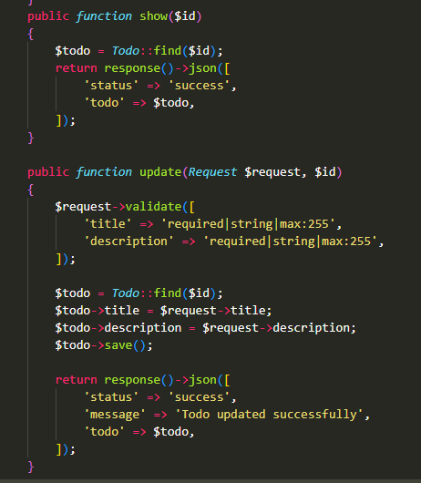
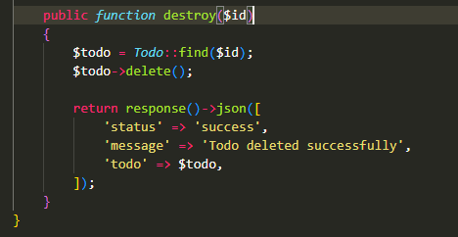
Modify the todo controller

Slide 12
Add the API routes

